Slide 1

CCH Tagetik team –
Quartlerly team meeting
June 2026

Slide 2
Agenda
1. Projets et opportunités Q1/Q2 2026 (15 min — Ben)
  Statut des mandats en cours
  Pipeline, opportunités en qualification et besoins de staffing
2. CCH Tagetik inTouch 2026 — recap et takeaways (25 min — Ben)
  Messages clés
  Leçons apprises des panels clients et implications pour nos mandats
3. Sessions de partage de connaissances (incluant Q&R)
  Automatisation de l'OSR — contexte, besoin métier, solution (Jeff – 30 min)
  Agent Tagetik Manuel Expert — statut après quelques mois : usage, valeur, limites (Thomas – 20min)
  Nouveautés SP36 et SP37 — fonctionnalités à retenir et impacts clients (Zhongdi – 20min)
4. Discussions d'équipe et varia (tous)

Slide 3
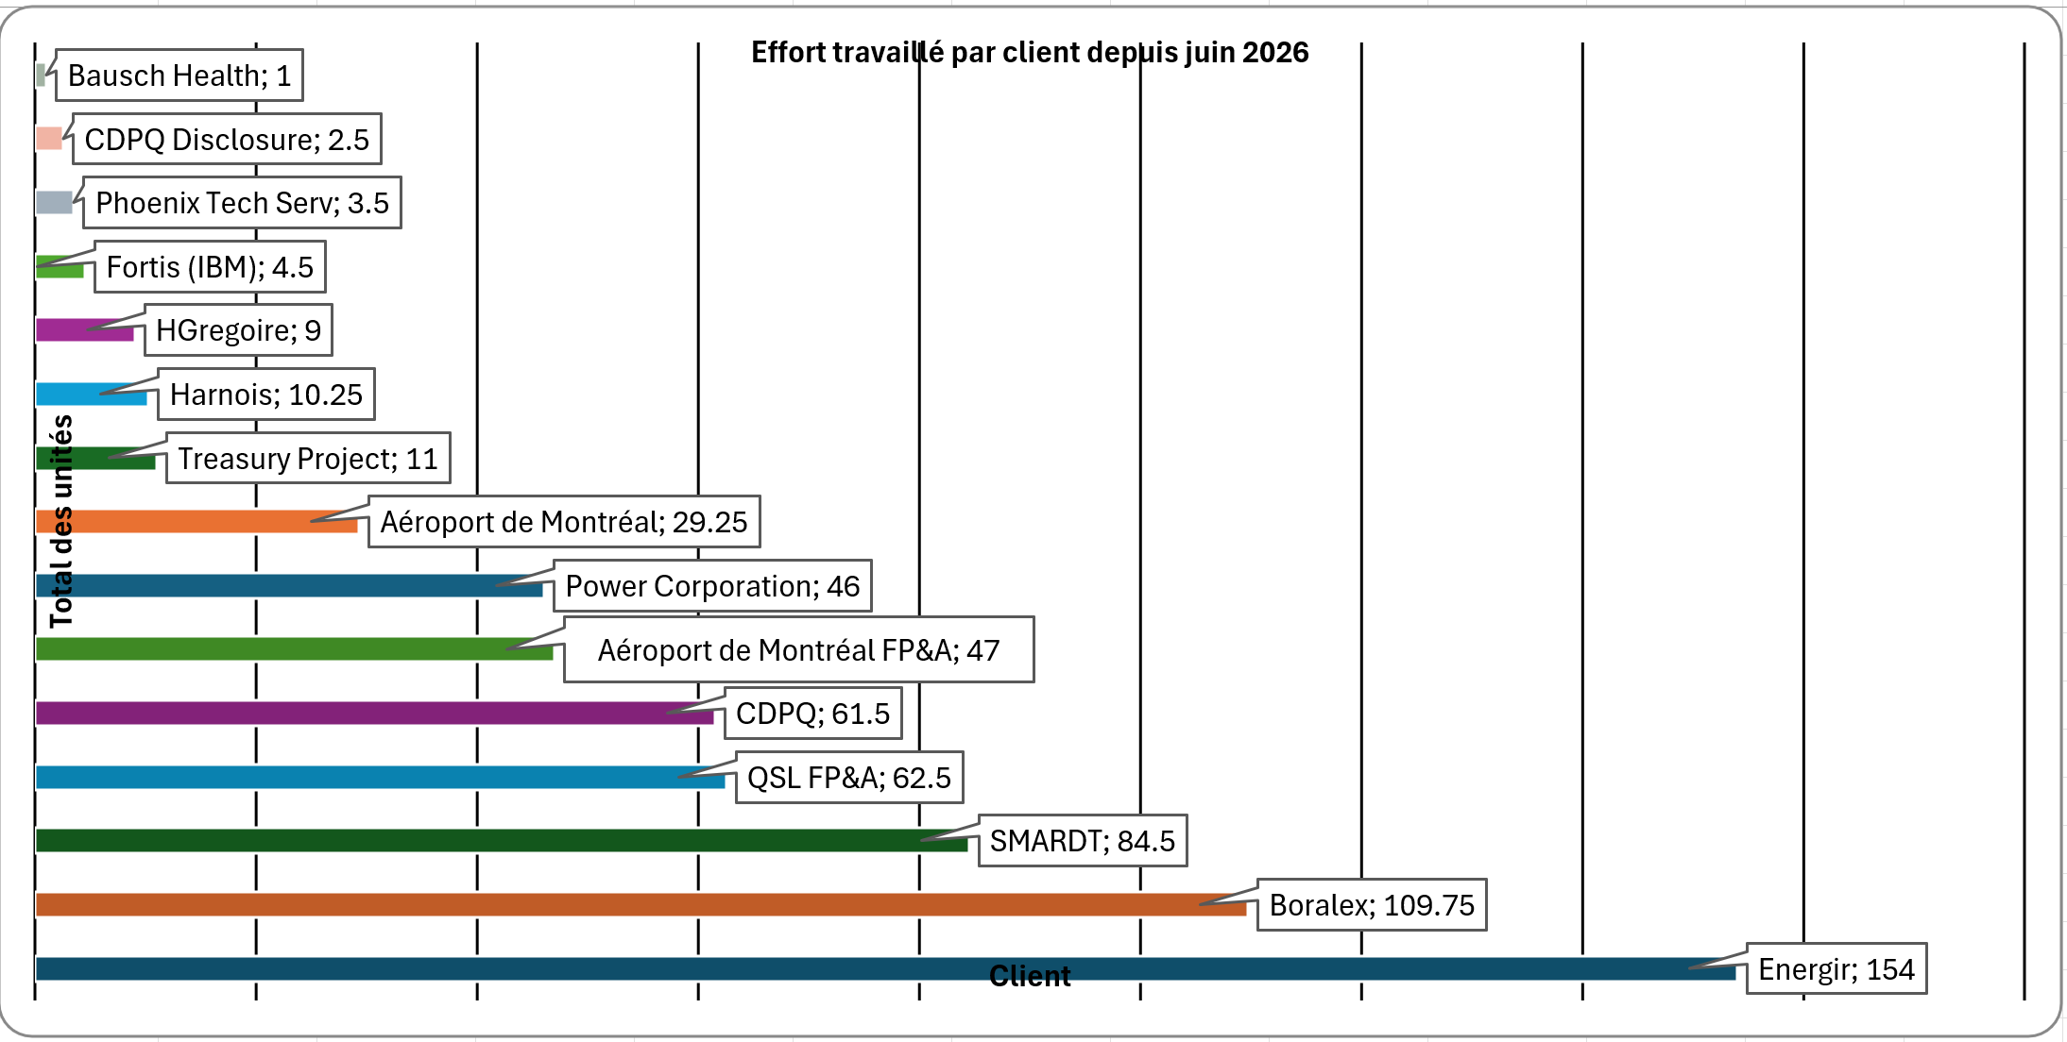
Projects – Since June 2026
In progress:
CDPQ (Conso)
AdM (Conso, Planning)
Boralex (Conso, Planning)
Energir (Conso)
QSL (Planning)
Power Corporation (Conso, ID)
Smardt (Conso and FP&A)
Hgregoire (Conso)
Not started:
Smardt (Conso DB merge, IC elim Planning, CF planning)
AIM (Conso evolutions)
Powercrop (Cash Flow)
Opportunities:
Premier Tech (Conso, Planning, ID)
Genetec (Conso, Planning, ID, GMT)
Stingray (Disclosure, Planning)
Anglian Water UK (Planning)
FedNav (Planning)
5NPlus (Planning – POC in progress)
…
Occupation client – Depuis juin 2026

Slide 4
Certifications CCH Tagetik — cibles et statut 2026
Feuille de route des certifications de l'équipe
Nom
Certification actuelle
Certification visée 2026
Statut
Houda Bastal
Platform Specialist
Conso Pro
Prévue — Q4 2026
Kendy Brice
Platform Builder
Conso Pro
Prévue — Q4 2026
Oumaima Laasri
Platform Builder
Platform Specialist
✓ Complétée
Bravo!
Thomas Jehaes
Platform Specialist
B&P Pro
Prévue — Q4 2026
1 / 6
Youssef Mashate
Platform Builder
Platform Specialist / B&P Pro
Prévue — Q4 2026
Zhongdi Wang
B&P Pro (expirée)
B&P Pro
certification 2026 complétée
Prévue — Q4 2026
5 restantes, toutes prévues au T4 2026
Pourquoi c'est important : les certifications sont une exigence clé de notre entente de partenariat avec CCH Tagetik North America. Elles renforcent notre statut de partenaire, notre crédibilité auprès des clients et notre accès aux opportunités de nouveaux projets.
Notes:
Les certifications sont importantes dans le cadre de notre entente de partenariat avec CCH Tagetik North America : elles soutiennent notre statut de partenaire, notre crédibilité auprès des clients et notre accès aux opportunités de co-vente. Féliciter Oumaima pour l'obtention de sa certification Platform Specialist. Valider avec chacun sa date d'examen prévue au T4 2026 et le soutien requis (temps d'étude, accès aux formations).

Slide 5
The core message of the 2026 edition — “Own the Future”
AI is no longer something to watch: it is running in production across EPM processes, and the Office of the CFO is in the driver's seat.
From experimentation to operations
Trust becomes the differentiator
The human stays in the loop
ML, GenAI and agentic use cases are being delivered in close, planning and disclosure — not in isolated POCs.
What separates platforms is no longer model power, but governance, auditability and data quality.
AI automates production work; the value of Finance shifts toward judgment, interpretation and decision-making.

Slide 6
Top 5 CFO priorities and challenges
Opening plenary
1
2
3
4
5
AI at scale
Data foundation
Faster decisions
Cost and growth
Talent and operating model
• Move from pilots to agentic workflows
• Redesign processes, measure value, keep oversight
• Finance becomes a value creator
• Data quality is now a board-level issue
• Simplify the landscape, define common master data
• Build an integrated data layer for AI
• Volatility demands faster decision cycles
• Predictive, real-time and rolling forecasts
• Track cash, capital and pricing continuously
• Improve margin while funding growth
• Manage costs strategically
• Cut low-value spend
• Automation is reshaping Finance roles
• Shift toward analytics, AI literacy, business partnering
• Upskill teams, build an analytics CoE

Slide 7
AI automates production work, FP&A owns the judgment
Traditional
AI-augmented
AI-embedded
Calculation-driven
Insight-driven
Decision-driven
• Number production, consolidation, reporting cycles
• Spreadsheet-centric analysis, manual variance work
• Backward-looking performance, control mindset
• Accuracy and compliance as primary value
• Automated data processing and AI-assisted analysis
• Faster variance detection and scenario exploration
• Increased analytical throughput with human validation
• Shift from reporting to interpretation
• Business judgment, decision framing, trade-offs
• Continuous interaction with business events
• Interpretation of signals and uncertainty
• Accountability for decisions and human oversight
›
›
AI changes the work — FP&A owns the judgment.

Slide 8
Toward event-driven, real-time forecasting
Embedded AI connects to enterprise data, enabling continuous planning, agent-driven analysis and autonomous execution.
TODAY'S LEADING ORGANIZATIONS
TOMORROW'S LEADING ORGANIZATIONS
• ML models generate forecasts from internal and external data
• Automatic identification of key drivers and their relative weight
• Human overlays in EPM systems for what the machine does not see
• Variance analysis focused on controllable drivers
• Agents monitor drivers continuously
• New forecasts generated as soon as a tolerance is breached
• Alternative scenarios created autonomously for consideration
• Recommended actions in response to change
• A narrative agent delivers the result to the FP&A analyst within hours
›

Slide 9
CCH Tagetik: a platform already built to support your AI journey
AI CONNECTIVITY with MCP
Trusted Ally
Human-in-the-loop by design. Every AI output is traceable, auditable and governed.
DISCOVER
with ML
See patterns, anomalies & drivers
ACCELERATE with GEN AI
Simplify task
& systems’ interaction
Finance BrainTM
One interface that speaks finance — applying your logic, not generic models.
ACT with
AGENTIC AI
Orchestrate workflows & execute decisions
AI Ecosystem
Connect to any enterprise AI ecosystem. Bring EPM data and enterprise metrics together.
ML discovers what your data hides. GenAI accelerates every finance task. Agentic AI acts securely on your behalf.
Notes:
“This is AI Finance can trust — CCH Tagetik Expert AI with a Finance Brain™.
This isn't one AI feature bolted on as an add-on; it's intelligence woven through every finance process: close, planning, reporting, disclosure. Wherever the work happens, Expert AI is already there.
It works on three layers, surrounded by a connective tissue. Discover uses ML to predict, detect and explain the data and drivers that move them. Accelerate uses GenAI to give teams with speed and confidence in numbers – ask a question in natural language, get the answer in seconds. Act uses Agentic AI to turn insight into action — automatically, and always under control. And AI Connectivity keeps it all open and governed — connecting agents, LLM and AI models across enterprise workflows.
It's built for Finance, and there are three key things that make it trustworthy: it's a Trusted Ally, with a human always in the loop; it's built with a Finance Brain™, that speaks your logic, not generic models; and it’s open - connecting to AI ecosystems to bring EPM data and enterprise metrics together. Pervasive, trusted, and open — from data, to decision, to action, auditable end-to-end. That's Expert AI."
CUSTOMER: “Extending your foundation with Expert AI is at your fingertips."
PROSPECT: "And it all comes embedded in the CCH Tagetik unified platform."
Transition out: "And because it's pervasive, it shows up at every stage of your workflow — let me show you exactly where."

Slide 10
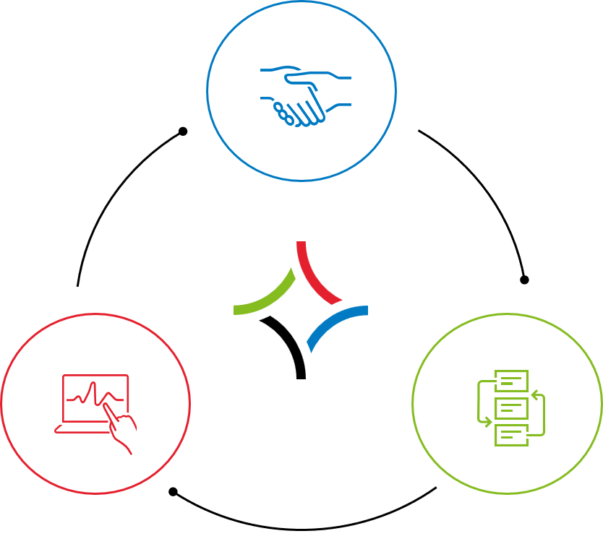
CCH Tagetik: AI woven through your financial workflow
DATA FOUNDATION
Structure data with trust and control
CLOSE
Close with speed and accuracy
PLAN
Model with agility and confidence
REPORT
Report with
clarity and impact
→
→
→
AI Automapping (ML)
Maps data automatically
AI Transaction Matching (ML)
Matches transactions
Predictive Intelligence (ML)
Predicts data, interprets KPIs
AI Driver-based Analysis (ML)
Uncovers key drivers
AI Anomaly-Detection (ML)
Spots variances
Variance Analyzer Agent
Explains discrepancies
AI Driver-based Analysis (ML)
Uncovers key drivers
Insight Designer Agent
Generates insights
Data Architect Agent
Structures, transforms data
Process Guardian Agent
Monitors balances and processes
AI Anomaly-Detection (ML)
Spots variances
Data Analyst Agent
Mines data
Data Extractor Agent
Extracts unstructured content
Consistency Controller Agent
Checks numbers correctness
Data Modeler Agent
Builds the data model
Data Interpreter Agent
Explains numbers
Helper Agent
Guides users through processes
Agentic Touchless Rec
Automates reconciliations
Agentic Planning Sentinel
Monitors and simulates plans
Agentic Variance Monitoring
Continuously tracks discrepancies
DISCOVER
ACCELERATE
ACT
Finance Systems Lead
Controller/VP Finance
FP&A Manager / Planner
Notes:
"Here you can really see what we mean when we say Expert AI is woven through your financial workflow. Whether Data Foundation, Close, Plan, and Report Expert AI supports your daily process with a set of purpose-built capabilities.
Now those capabilities are platform-wide and work across different process — what you see here is simply where they're used most. So, think of this as a guide, not a grid. Anomaly Detection lives under Data Foundation on this slide, but it's just as powerful in your Close or Planning; Variance Analysis appears under Report, yet you'll lean on it in Planning too. AI travels with you across the workflow — we've just placed each one at its most common home to keep the picture readable.
So rather than twenty tools in twenty boxes, what you're really looking at is one platform with purpose-built AI woven through your financial workflow — to use wherever the work takes you."
Transition: “So why does this win where other AI breaks — and does it actually pay off?”

Slide 11
Your EPM is the memory and the scoreboard
“The loop needs a ledger” — five conditions for AI output that can stand up to scrutiny.
SEMANTICS
The governed dimensional model
Every use case resolves “revenue by entity” the same way, every time.
GROUNDING
The Analytical Information Hub
Ledger detail and reported result in one place. Grounded, not guessed.
GUARDRAILS
Process, workflow, approvals
Real constraints and processes built with intention.
SCORING
The close calendar
The recurring event that grades what the agent ecosystem actually accomplished last cycle.
EVIDENCE
Statutory lineage
Auditability you already paid for — so output can enter a regulated process.

Slide 12
AI Connectivity: open, yet governed
“AI inside CCH Tagetik, AI beyond CCH Tagetik” — one platform: open, agnostic, Finance-grade.
Open by design
Extensible by MCP
Governed by default
Native A2A. Connects any agent, internal or external.
Plug in your agents, extend workflows across systems.
Data privacy, auditability and cloud choice built in.
• Universal agent-to-agent connectivity
• Orchestration layer across environments
• Goal: any agent collaborates, regardless of origin
• Fully pluggable architecture, no re-engineering
• Client-side and server-side MCP
• Goal: invoke third-party agents in a controlled way
• Read-only data virtualization — no customer data stored
• Multi-cloud, no infrastructure lock-in
• Goal: strong privacy and full customer control

Slide 13
Members 1st FCU: from data to decisions
Customer story
27%
$400K
Weeks › days
budget efficiency gain
in gains within 6 months
forecast cycle reduced
The application landscape
The AI capabilities enabled
• Sources: ERP, ALM, HR, assets
• Actuals (balance sheet and P&L) + FP&A: margin, workforce, CapEx, OpEx
• Reporting & disclosure: financial, narrative, PowerPoint, analysis
• Consumption: Word, PowerPoint, Excel, Power BI
• Predictive Intelligence (ML) for spread and loan growth projections
• AI Anomaly Detection for outlier detection and audit trail
• Three shifts: manual to continuous, reactive to predictive, Excel to AI
• Foundation set for agentic AI
“You don't need to be an expert in AI — but you do need to be an expert in your data. Trusted inputs lead to meaningful outputs.” — Brian Strohecker, Members 1st FCU

Slide 14
Lessons learned from the deployments presented
Customer panels
What they'd do again
What they'd do differently
• Separate ERP and EPM scope, but design them together architecturally
• Lead with consolidation, then build planning on the same data model
• Invest early in data quality, mappings and master data governance
• Review business processes before implementing the CPM solution
• Document key business requirements upfront and train power users early
• Engage business stakeholders even earlier, with design show-and-tells
• Challenge legacy BPC customizations instead of recreating them one-for-one
• Capture all critical use cases and test them thoroughly
• Allocate more training time on AI/ML forecasting and scenario tools
• Avoid customizations when standard meets the need, and keep buffer in the schedule

Slide 15
Our takeaways for client engagements
What this means for us
Bring AI into scoping from day one
Sell the foundation before the agent
Position ML and agentic capabilities in our scopings and demos, not as a theoretical phase 2.
Governed dimensional model, AIH, workflow and lineage: that is what makes AI usable at the client.
Plan for change management
Capitalize as a CoE
Training on AI/ML forecasting and scenario tools, and stakeholder involvement from design onward.
Document AI use cases by process and make them reusable across our engagements and GT teams.

Slide 17

Plan de formation CCH Tagetik
Formation et Certification Tagetik se font selon 2 axes principaux:
Consolidation
Budgeting & Planning

Slide 18


Plan de formation CCH Tagetik

Slide 19
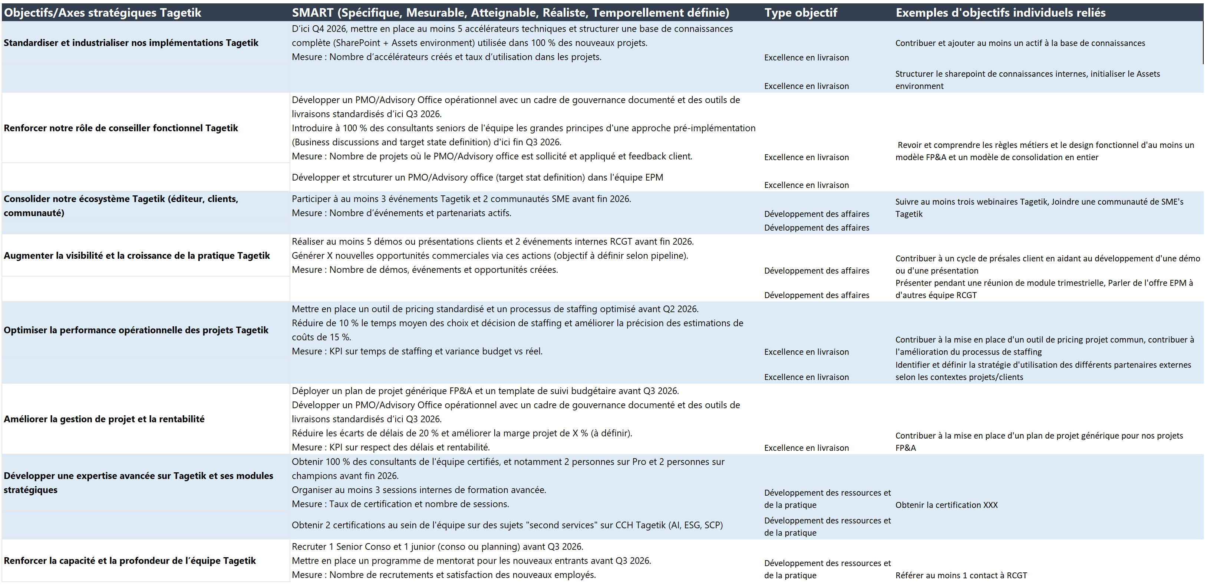
Objectifs 2026 de l’équipe Tagetik (Rappel)

Slide 20
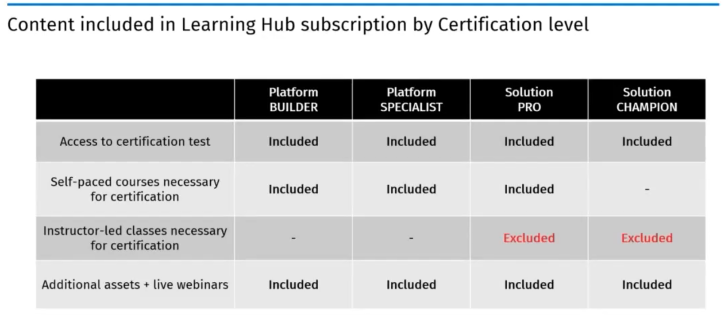
CCH Tagetik virtual partner kickoff – Faits saillants
For customer:
Admin: 1500 eur/year
Contributor: 250 eur/year
For partner:
TBC
Available in English, French, Italian

Slide 21
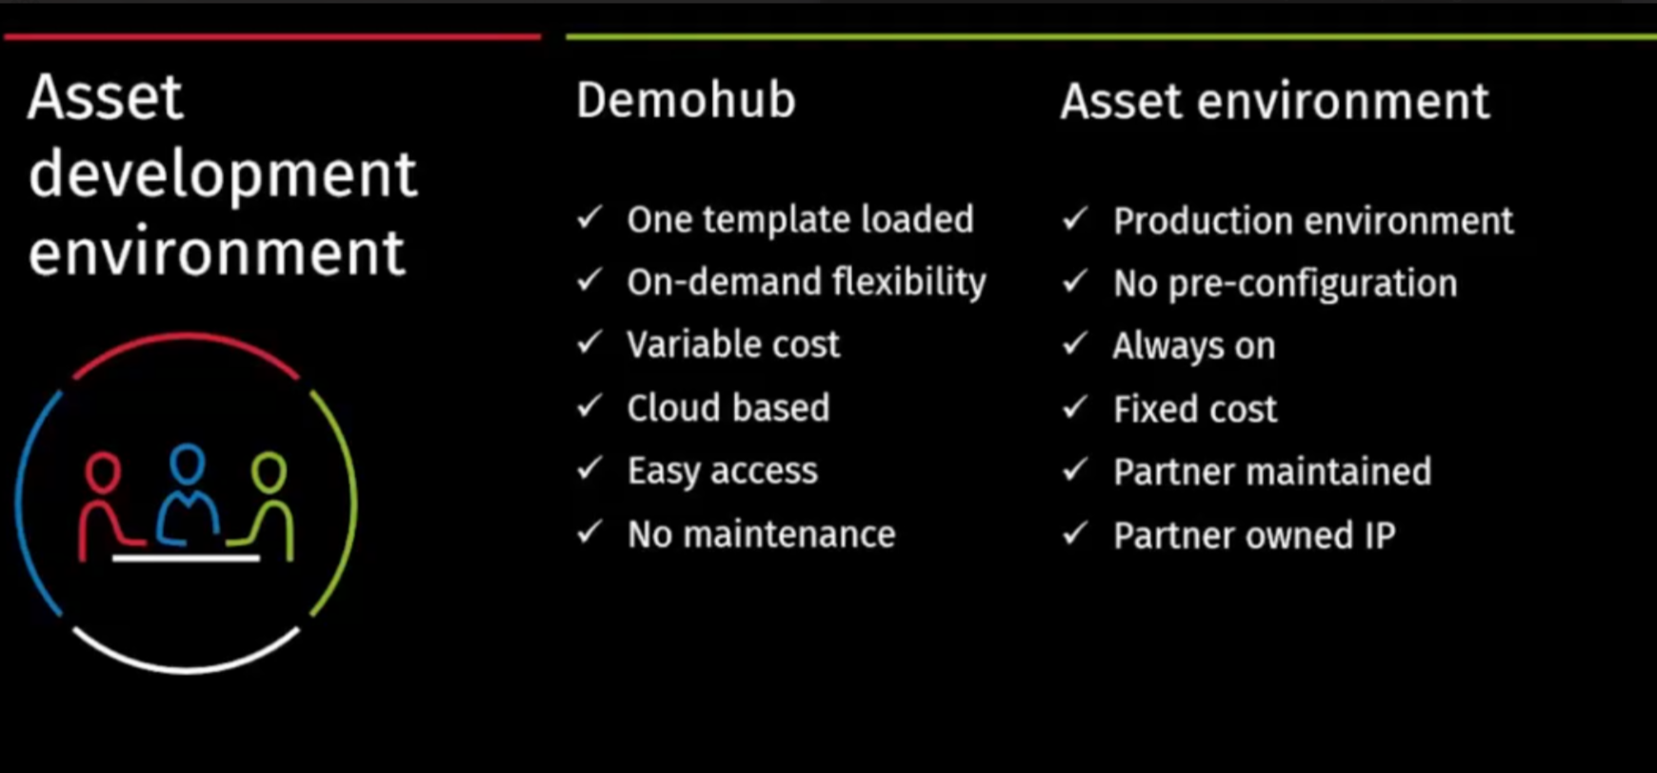
CCH Tagetik virtual partner kickoff – Faits saillants

